Slide 1
BLM2502 Theory of Computation
Spring 2016

Slide 2
BLM2502 Theory of Computation
Course Outline
Week Content
1 Introduction to Course
2 Computability Theory, Complexity Theory, Automata Theory, Set Theory, Relations, Proofs, Pigeonhole Principle
3 Regular Expressions
4 Finite Automata
5 Deterministic and Nondeterministic Finite Automata
6 Epsilon Transition, Equivalence of Automata
7 Pumping Theorem
8 April 10 - 14 week is the first midterm week
9 Context Free Grammars
10 Parse Tree, Ambiguity,
11 Pumping Theorem
12 Turing Machines, Recognition and Computation, Church-Turing Hypothesis
13 Turing Machines, Recognition and Computation, Church-Turing Hypothesis
14 May 22 – 27 week is the second midterm week
15 Review
16 Final Exam date will be announced

Slide 3
The Pumping Lemma for CFL's

Slide 4
Pumping Lemma
Recall the pumping lemma for regular languages.
It told us that if there was a string long enough to cause a cycle in the DFA for the language, then we could "pump" the cycle and discover an infinite sequence of strings that had to be in the language.
For CFL's the situation is a little more complicated.
We can always find two pieces of any sufficiently long string to "pump" in tandem.
That is: if we repeat each of the two pieces the same number of times, we get another string in the language.

Slide 5
Statement of the CFL Pumping Lemma
For every context-free language L There is an integer n, such that For every string z in L of length > n There exists z = uvwxy such that:
1. |vwx| < n.
2. |vx| > 0.
3. For all i > 0, uv^{i}wx^{i}y is in L.

Slide 6
Proof of the Pumping Lemma
Start with a CNF grammar for L - {ԑ}.
Let the grammar have m variables.
Pick n = 2^{m}.
Let |z| > n.
We claim ("Lemma 1") that a parse tree with yield z must have a path of length m+2 or more.

Slide 7
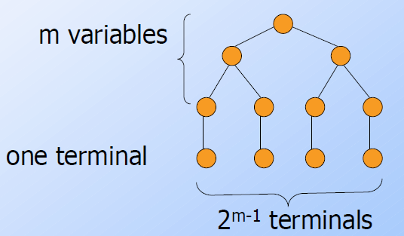
Proof of Lemma 1
If all paths in the parse tree of a CNF grammar are of length < m+1, then the longest yield has length 2^{m-1}, as in figure:

Slide 8
Proof of the Pumping Lemma
Now we know that the parse tree for z has a path with at least m+1 variables.
Consider some longest path.
There are only m different variables, so among the lowest m+1 we can find two nodes with the same label, say A.
The parse tree thus looks like:

Slide 9
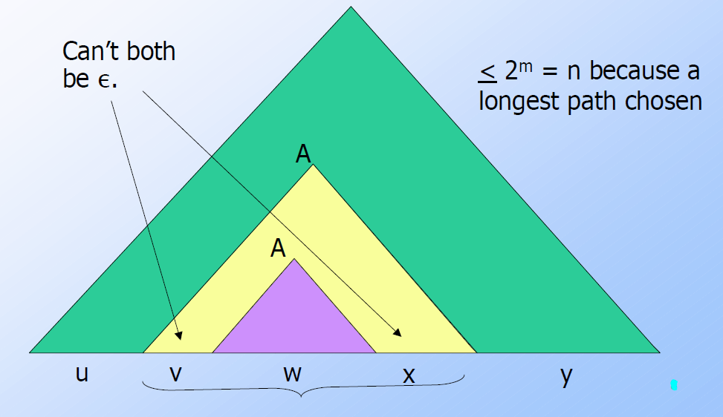
Parse Tree in the Pumping-Lemma

Slide 10
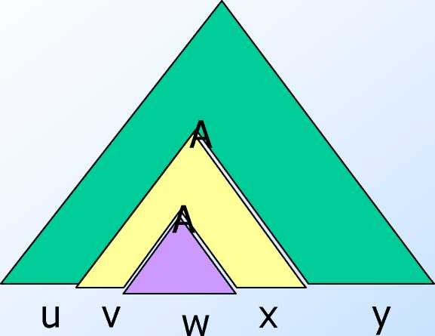
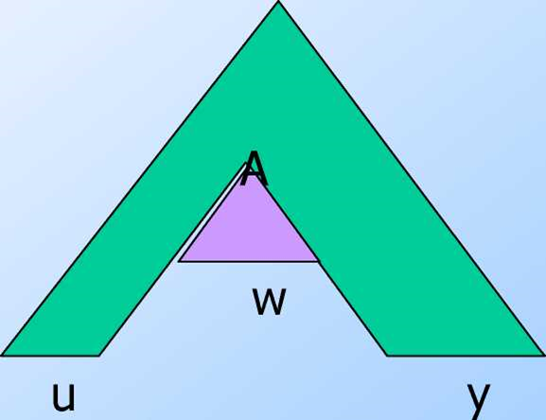
Pumping
Once
Zero times

Slide 11
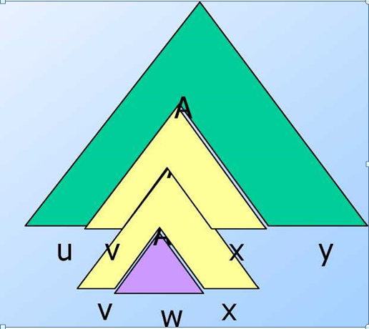
Pumping
Twice

Slide 12
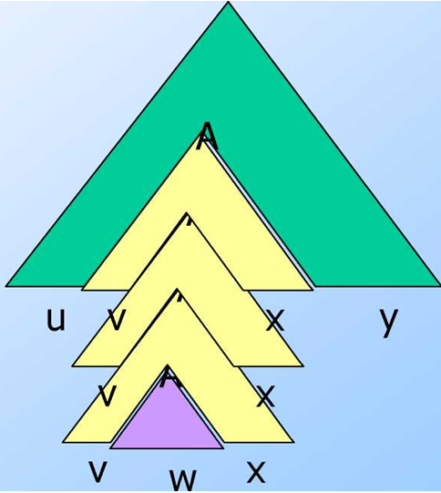
Pumping
Thrice, …

Slide 13
Using the Pumping Lemma
Non-CFL's typically involve trying to match two pairs of counts or match two strings.
Example: pumping lemma can be used to show that L = {ww | w in (0+1)*} is not a CFL.
{0'10' | i >1} is a CFL.
We can match one pair of counts.

Slide 14
Using the Pumping Lemma
L = {0^{i}10^{i}10^{i} | i >1} is not a CFL
We can't match two pairs, or three counts as a group.
Proof using the pumping lemma.
Suppose L were a CFL.
Let n be L's pumping-lemma constant.
Consider z = 0^{n}10^{n}10^{n}.
We can write z = uvwxy, where |vwx| < n, and |vx| > 1.
Case 1: vx has no 0's.
Then at least one of them is a 1, and uwy has at most one 1, which no string in L does.

Slide 15
Using the Pumping Lemma
Still considering z = 0^{n}10^{n}10^{n}.
Case 2: vx has at least one 0.
vwx is too short (length < n) to extend to all three blocks of 0's in 0^{n}10^{n}10^{n.}
Thus, uwy has at least one block of n 0's, and at least one block with fewer than n 0's.
Thus, uwy is not in L.

Slide 16
Simplifications of Context-Free Grammars

Slide 17
A Substitution Rule
Equivalent
grammar
Substitute

Slide 18
Substitute
Equivalent
grammar

Slide 19
In general:
Substitute
equivalent
grammar

Slide 20
Nullable Variables
Nullable Variable:
Example:
Nullable variable

Slide 21
Substitute
After we remove all the ε - productions
all the nullable variables disappear
(except for the start variable)

Slide 22
Unit-Productions
Unit Production:
(a single variable in both sides)
Example:
Unit Productions

Slide 23
Removal of unit productions:
Substitute

Slide 24
Unit productions of form
can be removed immediately
Remove

Slide 25
Substitute

Slide 26
Remove repeated productions
Final grammar

Slide 27
Useless Productions
Useless Production
Some derivations never terminate...

Slide 28
Another grammar:
Useless Production
Not reachable from S

Slide 29
In general:
If there is a derivation
consists of
terminals
Then variable is useful
Otherwise, variable is useless

Slide 30
A production is useless
if any of its variables is useless
Productions
Variables
useless
useless
useless
useless
useless
useless
useless

Slide 31
Removing Useless Variables and Productions
Example Grammar:

Slide 32
First:
find all variables that can produce
strings with only terminals or
(possible useful variables)
Round 1:
(the right hand side of production
that has only terminals)
Round 2:
(the right hand side of a production
has terminals and
variables of previous round)
This process can be generalized

Slide 33
Then, remove productions that use variables
other than

Slide 34
Second:
Find all variables
reachable from
Use a Dependency Graph
where nodes are variables
unreachable

Slide 35
Keep only the variables
reachable from S
Final Grammar
Contains only
useful variables

Slide 36
Removing All
Step 1: Remove Nullable Variables
Step 2: Remove Unit-Productions
Step 3: Remove Useless Variables
This sequence guarantees that
unwanted variables and productions
are removed

Slide 37
Normal Forms for Context-free Grammars

Slide 38
Chomsky Normal Form
Each productions has form:
or
variable
variable
terminal

Slide 39
Examples:
Chomsky
Normal Form
Not Chomsky
Normal Form

Slide 40
Conversion to Chomsky Normal Form
Example:
Not in Chomsky
Normal Form
We will convert it to Chomsky Normal Form

Slide 41
Introduce new variables for the terminals:

Slide 42
Introduce new intermediate variable
to break first production:

Slide 43
Introduce intermediate variable:

Slide 44
Final grammar in Chomsky Normal Form:
Initial grammar

Slide 45
In general:
From any context-free grammar
(which doesn’t produce ε )
not in Chomsky Normal Form
we can obtain:
an equivalent grammar
in Chomsky Normal Form

Slide 46
The Procedure
First remove:
Nullable variables
Unit productions
(Useless variables optional)

Slide 47
Then, for every symbol :
New variable:
Add production
In productions with length at least 2
replace with
Productions of form
do not need to change!

Slide 48
Replace any production
with
New intermediate variables:

Slide 49
Observations
Chomsky normal forms are good
for parsing and proving theorems
It is easy to find the Chomsky normal
form for any context-free grammar

Slide 50
Greinbach Normal Form
All productions have form:
symbol
variables

Slide 51
Examples:
Greinbach
Normal Form
Not Greinbach
Normal Form

Slide 52
Conversion to Greinbach Normal Form:
Greinbach
Normal Form

Slide 53
Observations
Greinbach normal forms are very good
for parsing strings (better than Chomsky Normal Forms)
However, it is difficult to find the
Greinbach normal of a grammar

Slide 54
BLM2502 Theory of Computation
?

